Slide 1




Proximity Operation Maneuvers at Asteroidal Deep Space In-Situ Resource Utilization Stations
Andrew Purkeypile
Mentor: Dr. Davide Conte

Slide 2
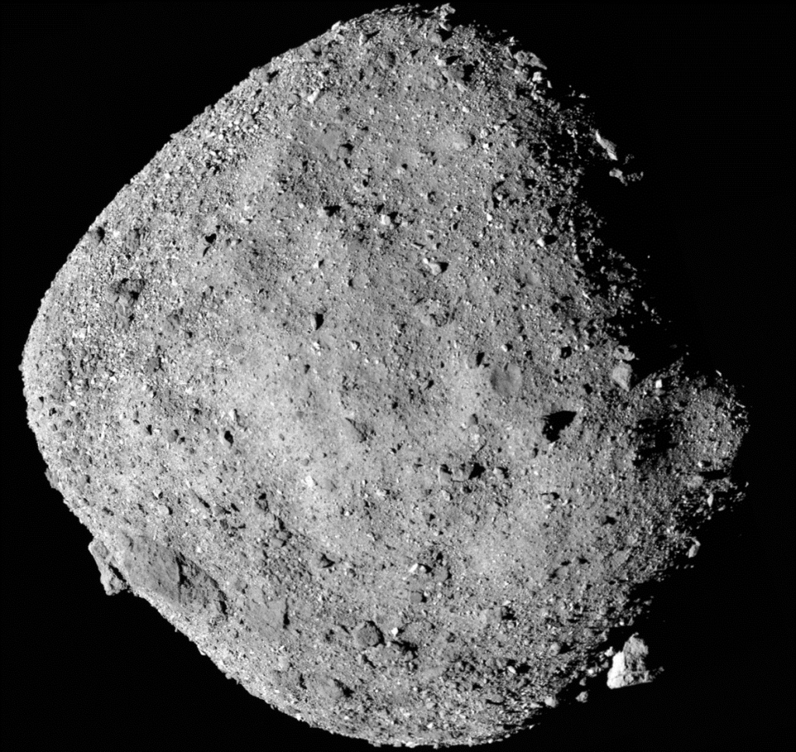

Background and Motivation
In-Situ Resource Utilization (ISRU)
Refueling at Asteroids on Interplanetary Missions
OSIRIS-Rex (Oct. 20, 2020)
  Surface sample return (Sep. 2023)
  Mission to Apophis (2026)
Planetary Defense Efforts
Asteroid 101955 Bennu: Courtesy NASA

Slide 3

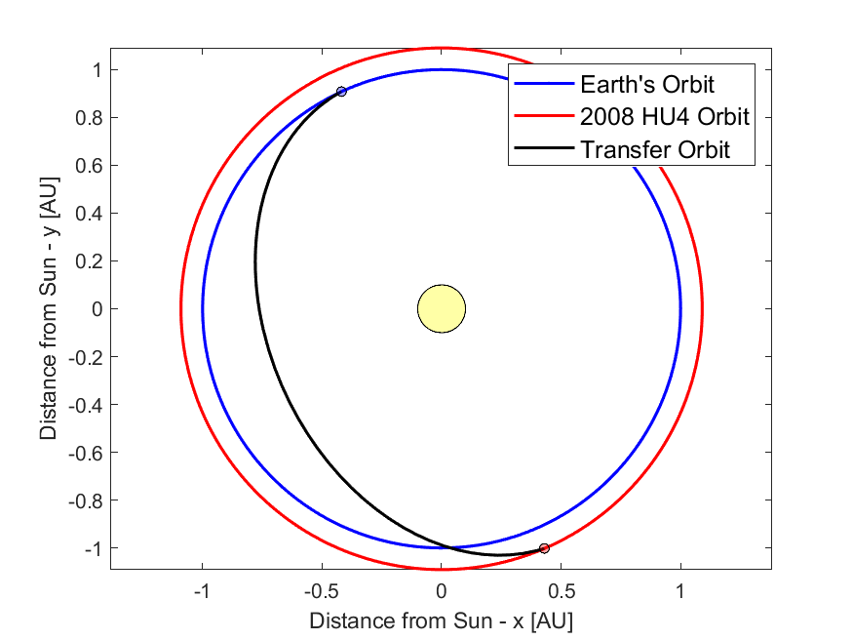
Earth to Asteroid Transfer
Asteroid 2008 HU4
Depart Earth – January 15, 2026
Arrival – July 9, 2026
Time of Flight – 175 days

Slide 4
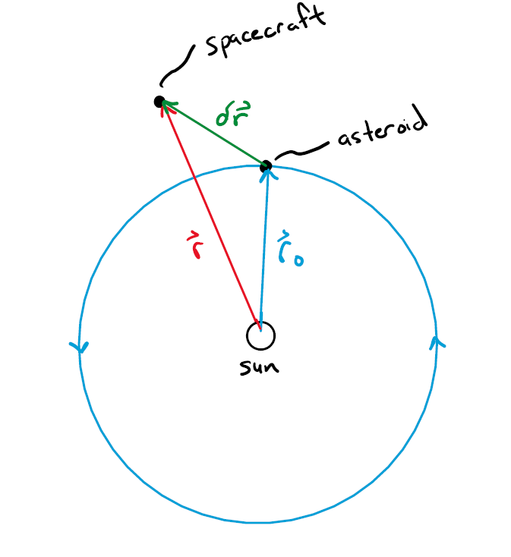
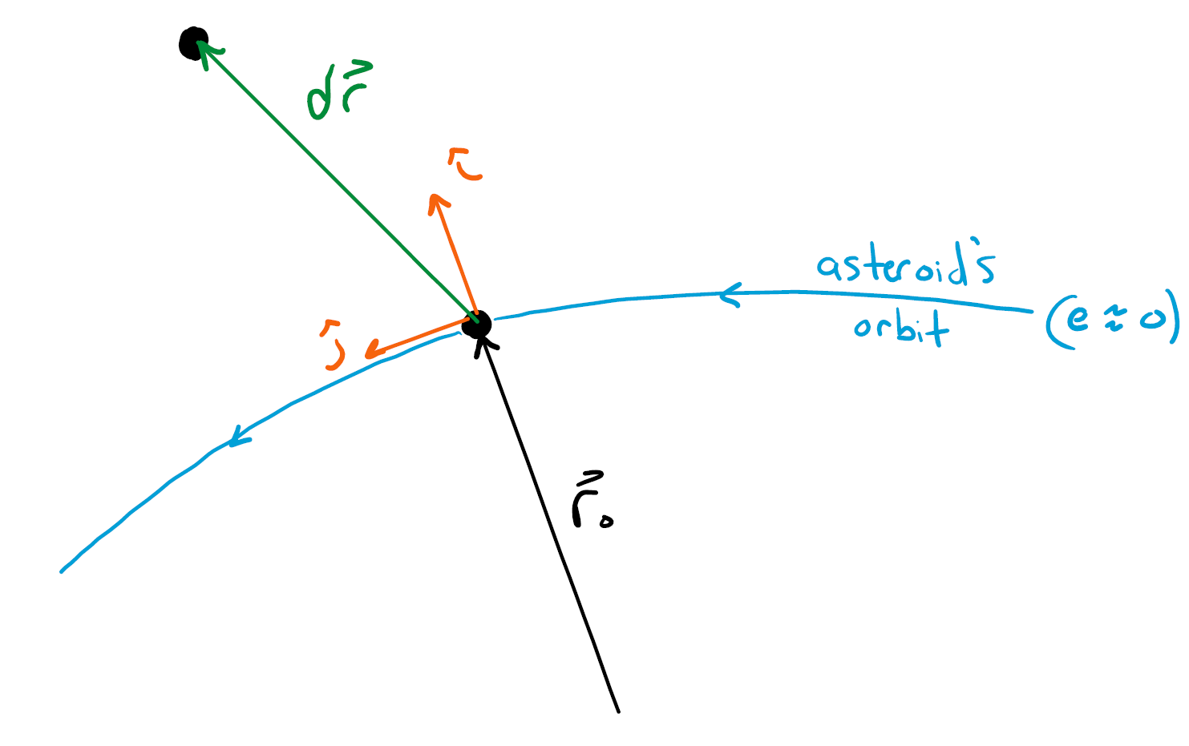
Rendezvous With the Asteroid
Note: Not to scale
Relative Position
Rotating Reference Frame

Slide 5
Equations of Motion (EOMs) for Relative Motion and Rendezvous
Hill-Clohessy-Wiltshire (HCW) EOMs
Assumptions:
  Target (asteroid) in circular orbit

Slide 6
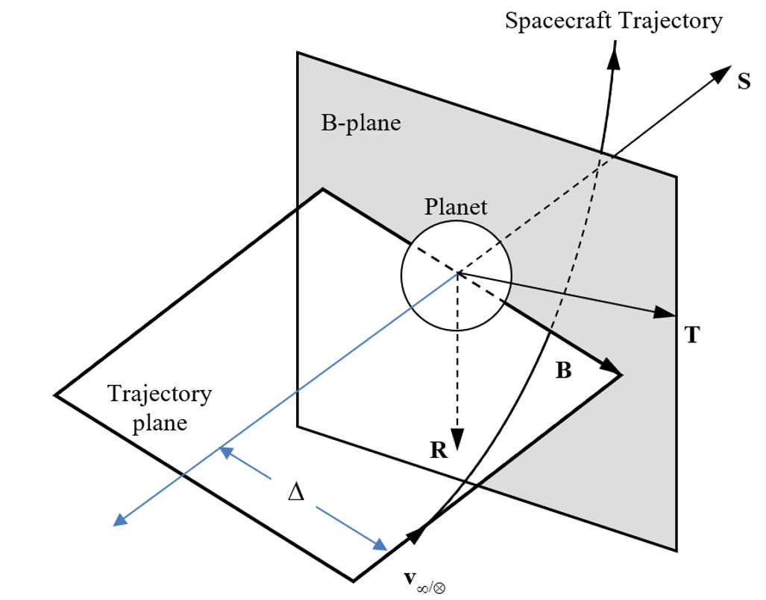
Learning How to Maneuver Around Asteroids
Body Plane targeting
Common Navigation Tool
Defined by:
  Ecliptic Plane
B-Plane and Impact Parameter [1]

Slide 7
Future Work
Determine:
Δv requirements for 2008 HU4 rendezvous
Δv distributions required for proximity operations when arriving at 2008 HU4 using B-Plane targeting methods

Slide 8
REFERENCES
[1] D. Spencer, and D. Conte, “Interplanetary Astrodynamics,” CRC Press, Taylor and Francis. 2023.

